Slide 1
Computer Networks
Chapter 1.2
ALOK KUMAR – ASSISTANT PROFESSOR & KARGIL TECHINCAL TRAINER (DCPD)
EMAIL: DCPD.KARGILT1@CUMAIL.IN

Slide 2
Contents
Network Reference Models: OSI Model & TCP IP
TCP protocol suite.
Basics of communication & modes.
Transmission modes: Guided & Unguided media
Physical layer: Introduction to physical layer devices, Transmission modes.
Introduction to multiplexing
Introduction to Modem

Slide 3
Network Reference Models
In the early days of computing, different hardware manufacturers built networks using their own proprietary rules. A computer built by Company A could not exchange data packets with a computer built by Company B because they formatted data, managed addresses, and controlled transmission speeds differently. This closed ecosystem prevented global communication.
To solve this, the computing industry needed a standardized, universal blueprint that breaks down the complex process of network communication into independent, manageable layers. Understanding Network Reference Models allows computer science engineers to develop hardware components and software applications that are universally compatible, ensuring that a web browser running on any operating system can communicate flawlessly with any web server across the globe.
Network communications are managed using structured layer architectures. Each layer has a specific job and communicates directly with the layers immediately above and below it.

Slide 4
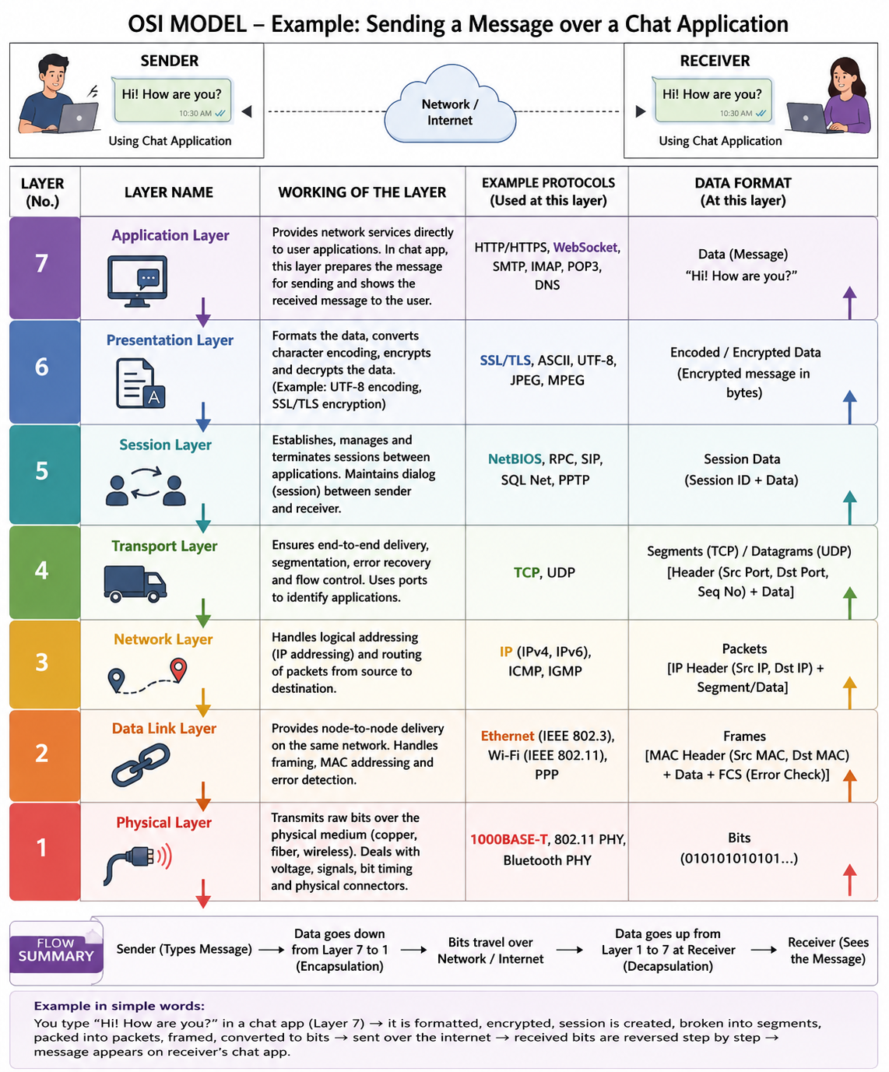
OSI - Layers

Slide 5
Layer 7: The Application Layer
The Application Layer is the topmost layer (Layer 7) of the OSI (Open Systems Interconnection) Model.
It is the layer that directly interacts with the user. Whenever we use applications such as WhatsApp, Gmail, Chrome, Firefox, YouTube, Zoom, or Instagram, we are actually working with the Application Layer.
We think that this layer is the application itself (like WhatsApp or Chrome), but that is not completely correct.
The Application Layer is not the application. It is a set of network services that allows an application to communicate over the network.
The Application Layer provides network services directly to the user applications and acts as the interface between the user and the network.

Slide 6
The Application Layer: Functionalities
Functionality | Description
Provides Network Services | Provides network services directly to user applications like browsers, email clients, and chat applications.
User Interface to the Network | Acts as the interface between the user and the network. The user communicates with the application, and the application communicates with the network through this layer.
Message Preparation | Takes the data entered by the user (text, image, video, document) and prepares it for transmission.
Resource Sharing | Allows users to access shared files, printers, cloud storage, and remote resources over the network.
Web Communication | Supports communication between web browsers and web servers for accessing websites.
File Transfer | Allows uploading and downloading files between computers.
Name Resolution Request | Requests domain name resolution (such as converting www.google.com into an IP address) through DNS services.
Remote Login | Allows users to access and control remote computers over a network.
Network Authentication | Helps verify user identity before providing access to network services.

Slide 7
The Application Layer: Protocols Used
Protocol | Purpose | Example
HTTP (HyperText Transfer Protocol) | Transfers web pages between browser and server. | Opening http://example.com
HTTPS (HyperText Transfer Protocol Secure) | Secure version of HTTP using encryption. | Opening https://www.google.com
FTP (File Transfer Protocol) | Transfers files between computers. | Uploading files to a server
SFTP (SSH File Transfer Protocol) | Secure file transfer over SSH. | Securely transferring files
SMTP (Simple Mail Transfer Protocol) | Sends emails. | Sending an email from Gmail
POP3 (Post Office Protocol Version 3) | Downloads emails from the mail server. | Reading emails on Outlook
IMAP (Internet Message Access Protocol) | Accesses emails while keeping them on the server. | Syncing emails across multiple devices
DNS (Domain Name System) | Converts domain names into IP addresses. | www.google.com → 142.xxx.xxx.xxx
DHCP (Application Layer in TCP/IP) | Automatically assigns IP addresses to devices. | Laptop connecting to Wi-Fi
Telnet | Remote login (not secure). | Managing old network devices
WebSocket | Enables two-way real-time communication. | WhatsApp Web, live chats, online games

Slide 8
Data Format (Protocol Data Unit - PDU) & Header
The Application Layer does not divide the message into packets or frames.
It simply passes the user's message to the lower layer (Presentation Layer).
Header Format
On application layer the header depends upon the protocol being used.
For example:
HTTP adds an HTTP Header.
SMTP adds an SMTP Header.
FTP adds FTP command information.
DNS adds a DNS message header.

Slide 9
WhatsApp Chat Example
Suppose you open WhatsApp and type: “Hello How Are You?”
At the Application Layer
The following happens:
You type the message.
WhatsApp receives the text.
WhatsApp prepares the message for sending.
It attaches application-related information (such as sender, receiver, and message ID).
It passes the prepared message to the Presentation Layer.
Important:
The message has not yet been encrypted, not divided into segments, and not converted into bits.
Those tasks are performed by the lower layers.

Slide 10
Presentation Layer
The Presentation Layer is the 6th layer of the OSI Model.
It is called the Translator of the OSI Model because it is responsible for making sure that the sender's data can be understood correctly by the receiver.
This layer performs three major tasks:
Data Translation (Format Conversion)
Data Encryption and Decryption
Data Compression and Decompression
The Presentation Layer is responsible for translating, encrypting, and compressing data before it is transmitted over the network.

Slide 11
The Presentation Layer: Functionalities
Functionality | Description
Data Translation | Converts data into a standard format so different devices and operating systems can understand it correctly. Eg: PC-A stores data in UTF-8 format & PC-B expects data in ASCII format.
Character Encoding | Converts characters into machine-readable formats such as ASCII or UTF-8.
Data Encryption | Encrypts the data before transmission so unauthorized users cannot read it.
Data Decryption | Decrypts the received encrypted data so the original message can be read.
Data Compression | Compresses data to reduce its size, allowing faster transmission and reduced bandwidth usage.
Data Decompression | Restores compressed data back to its original form after reception.
Format Conversion | Converts files, images, audio, or video into compatible formats for different devices and applications.
Remote Login | Allows users to access and control remote computers over a network.
Network Authentication | Helps verify user identity before providing access to network services.

Slide 12
The Presentation Layer: Protocols Used
Protocol / Technology | Purpose
SSL (Secure Sockets Layer) | Encrypts communication between applications. (Older technology)
TLS (Transport Layer Security) | Modern encryption protocol used in HTTPS, WhatsApp, banking, etc.
ASCII | Standard character encoding for English text.
UTF-8 | Universal character encoding supporting almost all languages.
Unicode | Character encoding standard supporting global languages and symbols.
JPEG / JPG | Image compression format.
PNG | Lossless image format.
GIF | Animated image format.
MPEG / MP4 | Video compression formats.
MP3 | Audio compression format.
AAC | Audio encoding format used in multimedia.

Slide 13
Data Format (Protocol Data Unit - PDU) & Header
The PDU at the Presentation Layer is still: DATA
However, the data is now:
Encoded
Encrypted
Possibly compressed
Header Format
The Presentation Layer does not add a standard OSI header like the Transport or Network layers.
Instead, it performs data transformation.
Depending on the application, it may include information such as:
Encryption details
Character encoding information
Compression information

Slide 14
Session Layer
The Session Layer is the 5th layer of the OSI Model.
Its main job is to establish, maintain, and terminate a communication session between two devices.
A session is simply a communication period during which two devices exchange data.
The Session Layer establishes, manages, and terminates communication sessions between applications.

Slide 15
Session Layer: Why do we even need it?
Suppose you are having a WhatsApp voice call with your friend.
Before talking:
The call must be connected.
While talking:
The connection must remain active.
Both users should continue communicating without interruption.
When the conversation ends:
The call must disconnect properly.
This entire process is managed by the Session Layer.
Without it:
Every message would require creating a new connection.
Interrupted communication could not be resumed.
Long conversations would become difficult to manage.

Slide 16
The Session Layer: Functionalities
Functionality | Description
Session Establishment | Creates a communication session between the sender and receiver before data transfer begins.
Session Management | Keeps the communication active while data is being exchanged.
Session Termination | Closes the communication session after the data transfer is complete.
Dialog Control | Controls which device can send data and when, especially in half-duplex communication.
Synchronization | Inserts checkpoints during long data transfers so communication can resume from the last successful point if interrupted.
Session Recovery | Restores communication from the last checkpoint instead of restarting the entire transfer after a failure.
Authentication Support | Helps maintain authenticated sessions after a user successfully logs in.

Slide 17
The Session Layer: Protocols Used
Protocol | Purpose | Example
NetBIOS | Establishes and manages sessions between Windows computers on a local network. | Windows file and printer sharing
RPC (Remote Procedure Call) | Allows a program on one computer to execute functions on another computer. | Client-server applications
SIP (Session Initiation Protocol) | Establishes, manages, and terminates voice and video communication sessions. | WhatsApp Calling, VoIP, Zoom, Microsoft Teams
PPTP (Point-to-Point Tunneling Protocol) | Creates VPN communication sessions. | Older VPN connections
SQL*Net / Oracle Net | Manages communication sessions between Oracle Database clients and servers. | Database applications

Slide 18
Data Format (Protocol Data Unit - PDU) & Header
The PDU at the Presentation Layer is still: DATA
Header Format
Unlike the Network or Transport layers, there is no universal Session Layer header defined in the OSI model.
Instead, session-related information may include:
Session ID
Session Token
Dialog Control Information
Synchronization (Checkpoint) Information

Slide 19
WhatsApp Chat Example
Suppose you send:
Hi! How are you?
At the Application Layer
You type the message.
↓
Presentation Layer
The message is encoded and encrypted.
↓
Session Layer
Before the message is sent:
A communication session between your WhatsApp and your friend's WhatsApp is established.
The session remains active while messages are exchanged.
Every new message ("Hi", "How are you?", "I'm fine") uses the same active session.
When you close the chat or the communication ends, the session is terminated.
Important: The Session Layer does not create the message or encrypt it. It simply manages the communication session.

Slide 20
Transport Layer
The Transport Layer is the 4th layer of the OSI Model.
Its main responsibility is to provide end-to-end communication between the sender and the receiver.
Think of it as a delivery manager. It makes sure that the complete message reaches the correct application on the destination device.
Unlike the lower layers, which mainly move data between devices or networks, the Transport Layer ensures that:
The complete message reaches the destination.
Data arrives in the correct order (when using TCP).
Missing data is retransmitted if necessary.
Multiple applications on the same computer receive the correct data using port numbers.
The Transport Layer provides end-to-end communication, divides data into smaller segments, ensures reliable delivery (when required), and delivers data to the correct application using port numbers.

Slide 21
The Transport Layer: Functionalities
Functionality | Description
End-to-End Communication | Provides communication between the source application and the destination application.
Segmentation | Divides large data into smaller segments for easier transmission.
Reassembly | Combines all received segments back into the original message at the destination.
Port Addressing | Uses port numbers to deliver data to the correct application (e.g., browser, WhatsApp, email).
Reliable Delivery (TCP) | Ensures that all data reaches the destination correctly using acknowledgments and retransmissions.
Error Recovery | Detects lost segments and requests retransmission.
Flow Control | Prevents the sender from sending data faster than the receiver can process it.
Connection Management | Establishes and terminates connections when using TCP.
Multiplexing and Demultiplexing | Allows multiple applications to send and receive data simultaneously using different port numbers.

Slide 22
The Transport Layer: Protocols
TCP | UDP
Connection-Oriented | Connectionless
Reliable | Unreliable
Acknowledgment Required | No Acknowledgment
Error Recovery | No Error Recovery
Slower | Faster
Used for Email, Web Browsing, Banking | Used for Video Streaming, Gaming, DNS, Voice Calls

Slide 23
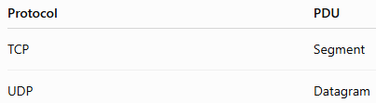
The Transport Layer: Data Format (Protocol Data Unit)
At the Transport Layer,
the data is divided into:
Segments (TCP)
or
Datagrams (UDP)

Slide 24
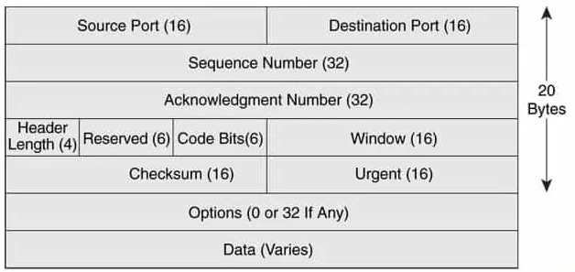
The Transport Layer: Header Format (TCP)
Field | Purpose
Source Port | Port number of sender application
Destination Port | Port number of receiver application
Sequence Number | Keeps segments in the correct order
Acknowledgment Number | Confirms successful receipt
Flags | Controls connection (SYN, ACK, FIN, etc.)
Window Size | Used for flow control
Checksum | Detects transmission errors
The TCP Header has:
Minimum Size: 20 Bytes
Maximum Size: 60 Bytes

Slide 25
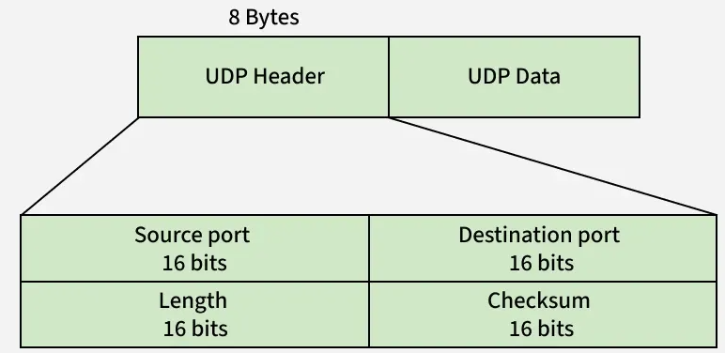
The Transport Layer: Header Format (UDP)

Slide 26
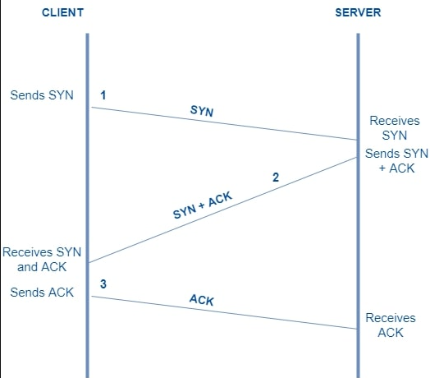
The Transport Layer: 3-way handshake
The TCP Three-Way Handshake is one of the most important concepts of the Transport Layer.
In fact, it is the first process that happens before TCP starts sending actual data.

Slide 27
Network Layer
The Network Layer is the 3rd layer of the OSI Model.
Its primary responsibility is to deliver data from the source network to the destination network.
Unlike the Transport Layer, which communicates application-to-application, the Network Layer communicates device-to-device across different networks.
It identifies every device using a Logical Address (IP Address) and decides the best path to deliver the data.
The Network Layer is responsible for logical addressing, routing, path selection, and forwarding packets from the source network to the destination network.

Slide 28
The Network Layer: Functionalities
Functionality | Description
Logical Addressing | Assigns and uses IP addresses to uniquely identify devices on different networks.
Routing | Determines the best path for data to travel from source to destination.
Packet Forwarding | Forwards packets from one router to another until they reach the destination.
Path Selection | Chooses the most efficient route based on routing information.
Internetworking | Enables communication between different networks (LAN to LAN through routers).
Fragmentation | Splits large packets into smaller fragments when required by the Maximum Transmission Unit (MTU).
Reassembly | The destination host reassembles fragmented packets into the original packet.
Congestion Handling | Some network-layer protocols and routers help manage traffic congestion.

Slide 29
The Network Layer: Protocols
Protocol | Purpose
IPv4 (Internet Protocol Version 4) | Provides logical addressing and packet delivery using 32-bit IP addresses.
IPv6 (Internet Protocol Version 6) | Uses 128-bit IP addresses to overcome IPv4 address limitations.
ICMP (Internet Control Message Protocol) | Reports errors and performs diagnostics (used by the ping command).
IGMP (Internet Group Management Protocol) | Manages multicast group memberships.
IPsec (Internet Protocol Security) | Provides security services such as authentication and encryption for IP packets.
OSPF (Open Shortest Path First) | Dynamic routing protocol used within an organization.
RIP (Routing Information Protocol) | Distance-vector routing protocol based on hop count.
EIGRP (Enhanced Interior Gateway Routing Protocol) | Cisco routing protocol for efficient path selection.
BGP (Border Gateway Protocol) | Used to exchange routing information between Internet Service Providers (ISPs).

Slide 30
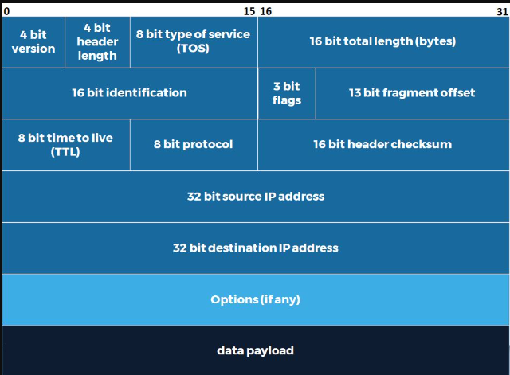
Data Format (Protocol Data Unit - PDU) & Header
The PDU of the Network Layer is: Packet

Slide 31
Data Format (Protocol Data Unit - PDU) & Header
The PDU of the Network Layer is: Packet
Field | Purpose
Version | Indicates IPv4 or IPv6.
Header Length | Specifies the size of the IP header.
Total Length | Total size of the packet.
Identification | Used during packet fragmentation and reassembly.
Flags | Controls fragmentation behavior.
Fragment Offset | Indicates the position of each fragment.
Time To Live (TTL) | Prevents packets from circulating forever by decreasing at each router.
Protocol | Specifies the upper-layer protocol (e.g., TCP, UDP, ICMP).
Header Checksum | Detects errors in the IP header.
Source IP Address | Logical address of the sender.
Destination IP Address | Logical address of the receiver.
Header Size
For IPv4:
Minimum Header = 20 Bytes
Maximum Header = 60 Bytes
For IPv6:
Fixed Header = 40 Bytes

Slide 32
Data Format (Protocol Data Unit - PDU) & Header
Suppose you send:
Hi! How are you?
Application Layer
Creates the message.
↓
Presentation Layer
Encrypts and formats the message.
↓
Session Layer
Maintains the communication session.
↓
Transport Layer
Creates TCP segments and adds port numbers.
↓
Network Layer
The Network Layer:
Adds the Source IP Address (your device).
Adds the Destination IP Address (your friend's device).
Creates an IP packet.
Determines the best route through the Internet.
Forwards the packet to the next router.
Example:
Source IP : 192.168.1.20
Destination IP : 103.21.58.100
The packet is now ready to move through routers across different networks

Slide 33
Data Link Layer
The Data Link Layer is the 2nd layer of the OSI Model.
Its main responsibility is to provide node-to-node delivery of data over the same local network (LAN).
Unlike the Network Layer, which uses IP Addresses to deliver packets between different networks, the Data Link Layer uses MAC Addresses to deliver data between devices connected to the same network.
It also detects transmission errors and controls access to the communication medium.
The Data Link Layer is responsible for node-to-node communication, framing, physical addressing (MAC Address), error detection, and media access control within the same local network.

Slide 34
The Data Link Layer: Functionalities
Functionality | Description
Framing | Converts Network Layer packets into frames before transmission.
Physical Addressing | Uses MAC Addresses to identify sender and receiver within the same LAN.
Error Detection | Detects transmission errors using FCS (Frame Check Sequence) or CRC.
Media Access Control | Controls how devices access the communication medium to avoid collisions.
Flow Control | Prevents a fast sender from overwhelming a slow receiver on the local link.
Node-to-Node Delivery | Delivers data between directly connected devices in the same network.
Frame Synchronization | Marks the beginning and end of each frame.

Slide 35
The Data Link Layer: Protocols
Protocol / Standard | Purpose
Ethernet (IEEE 802.3) | Wired LAN communication.
Wi-Fi (IEEE 802.11 MAC) | Wireless LAN communication.
PPP (Point-to-Point Protocol) | Direct communication between two devices based on mac address .
HDLC (High-Level Data Link Control) | Reliable communication over point-to-point links.
Frame Relay | WAN data link technology (legacy).
ATM (Asynchronous Transfer Mode) | High-speed switching technology (legacy).

Slide 36
PDU, Header & Trailer
The PDU at the Data Link Layer is still: Frame
Header Format
The Data Link Layer adds both:
Header
Trailer
Unlike every other layer.

Slide 37
The Data Link Layer: Sub-Layers
Feature | LLC (Logical Link Control) | MAC (Media Access Control)
Full Form | Logical Link Control | Media Access Control
Standard | IEEE 802.2 | IEEE 802.3 (Ethernet), IEEE 802.11 (Wi-Fi)
Position | Upper sublayer of the Data Link Layer | Lower sublayer of the Data Link Layer
Main Function | Provides communication between the Network Layer and the MAC sublayer. | Controls access to the physical transmission medium and handles frame transmission.
Primary Responsibility | Identifies the Network Layer protocol and provides logical communication. | Uses MAC addresses and controls how devices transmit data on the network.
Address Used | Does not use MAC addresses. | Uses Source MAC Address and Destination MAC Address.

Slide 38
The Data Link Layer: Sub-Layers
Feature | LLC (Logical Link Control) | MAC (Media Access Control)
Frame Handling | Passes data to the MAC sublayer. | Creates and processes Ethernet/Wi-Fi frames.
Media Access | Does not control access to the network medium. | Decides when a device can transmit data to avoid collisions.
Communication Type | Logical communication between Network Layer and MAC Layer. | Physical communication over the network medium.
Protocols/Standards | IEEE 802.2 | Ethernet (IEEE 802.3), Wi-Fi (IEEE 802.11)
Error Handling | May provide logical flow and error management depending on implementation. | Detects frame errors using FCS (CRC).
Works With | Network Layer | Physical Layer

Slide 39
Physical Layer
The Physical Layer is the first layer of the OSI Model.
It is responsible for transmitting the actual data over the communication medium in the form of electrical signals, optical signals, or radio waves.
It defines:
What type of cable will be used?
What connector will be used?
What voltage represents binary 1 and binary 0?
What is the transmission speed?
How are devices physically connected?
The Physical Layer is responsible for transmitting raw bits (0s and 1s) over the physical communication medium using electrical, optical, or wireless signals.

Slide 40
Physical Layer: Why do we need it?
Imagine you type the following message in WhatsApp: “Hi Deven”.
The Application Layer understands it as text.
The Transport Layer converts it into segments.
The Network Layer creates packets.
The Data Link Layer creates frames.
But can a cable understand: Frames?, the answer is NO.
A cable only carries 0 or 1 therefore, The Physical Layer converts the frame into electrical signals, optical pulses, or radio waves for transmission.
Without the Physical Layer:
No data could travel through cables.
No Wi-Fi communication would occur.
No fiber optic communication would be possible.

Slide 41
The Physical Layer: Functionalities
Functionality | Description
Bit Transmission | Transmits data as bits (0s and 1s).
Signal Generation | Converts digital bits into electrical, optical, or radio signals.
Signal Reception | Receives signals and converts them back into bits.
Data Encoding | Defines how binary data is represented on the transmission medium.
Transmission Medium Specification | Defines cables, connectors, and wireless media.
Data Rate Specification | Defines the transmission speed (bps, Mbps, Gbps).
Physical Topology | Defines how devices are physically connected.
Synchronization | Ensures sender and receiver remain synchronized while transmitting bits.

Slide 42
The Physical Layer: Devices Used
Device | Purpose
Hub | Broadcasts incoming signals to all connected devices. It does not examine MAC addresses or frames.
Repeater | Regenerates weak signals to extend transmission distance.
Modem | Converts digital signals to analog signals and vice versa for communication over certain media.
Network Cable | Carries signals between devices.
RJ45 Connector | Connects Ethernet cables to network devices.
Fiber Optic Cable | Uses light pulses for high-speed communication.
Wireless Antenna / Access Point Radio | Sends and receives radio signals for wireless communication.

Slide 43
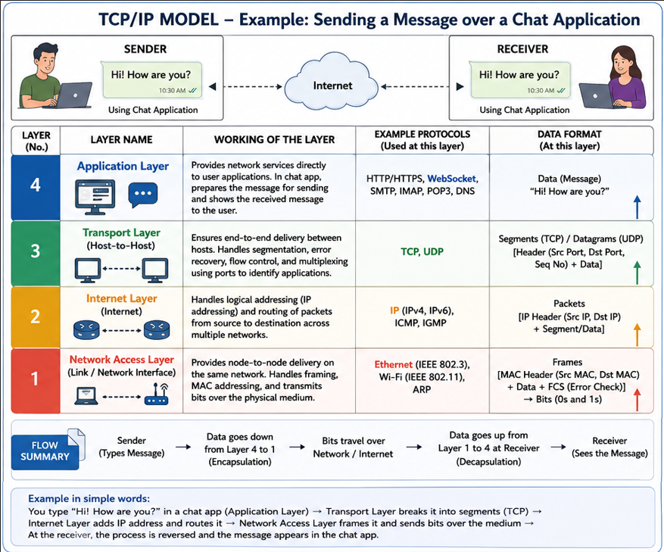

Slide 44
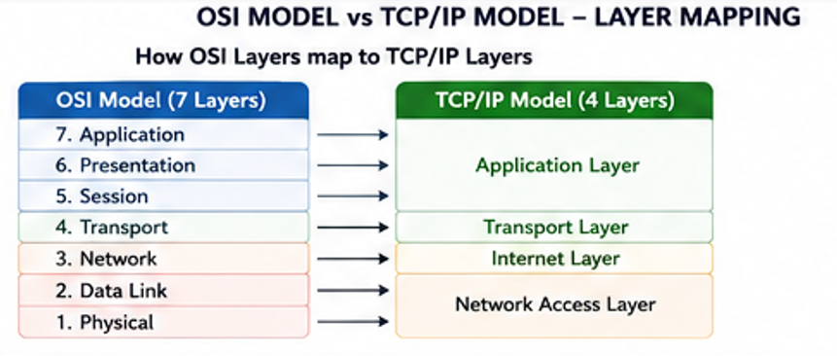
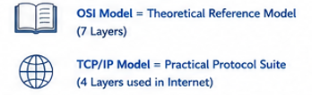
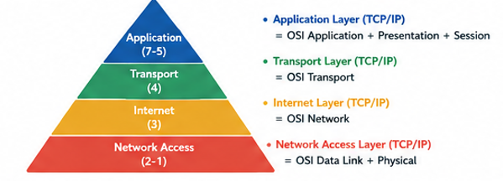

Slide 45
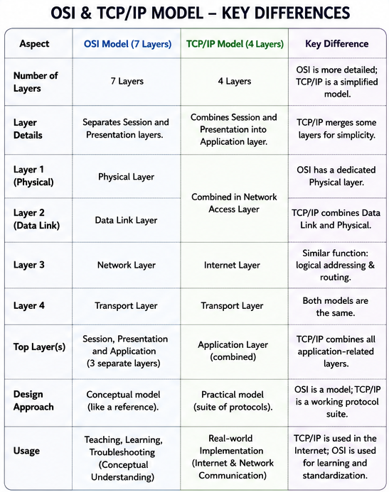

Slide 46
Transmission Media (Guided vs Unguided Media)
Once our software applications have formatted data packets and determined their destination paths using reference models, those packets must physically leave the device. At the lowest level of the network stack, data packets cannot travel as abstract software structures. They must be converted into physical signals—such as electrical voltage changes down a copper wire, pulses of light through a glass strand, or radio waves traveling through the air.
If we choose the wrong physical pathway, our data packets can suffer from severe degradation over long distances, experience data corruption from external environmental noise, or fail to achieve the bandwidth speeds required by modern software applications. Understanding Transmission Media gives engineers the exact physical blueprints needed to select the right cabling or wireless technologies based on distance, budget, speed requirements, and environmental factors.

Slide 47
Transmission Media
In computer networks, Transmission Media are the physical pathways used to carry data packets from one device to another. As an engineer, we must understand the different types of pathways available, both wired and wireless, so we can choose the right one based on distance, speed, budget, and environmental conditions.
All transmission media fall into two major categories:
Guided Media (Wired): Pathways where the data packets are physically bound, directed, and confined inside a solid, tangible conductor (like a copper wire or glass cable). The data flows exactly along the physical path of the cable.
Unguided Media (Wireless): Pathways where data packets travel through the open air, water, or vacuum of space without being confined to a physical path. The signals are broadcast out as electromagnetic waves for anyone with an antenna to catch.

Slide 48
GUIDED MEDIA (WIRED) – Twisted Pair Cable
What is a Twisted Pair Cable?
It is the most common type of wired network cable, consisting of pairs of color-coded copper wires twisted around each other.
The twisting design is a clever engineering trick: it causes the electrical interference from outside sources (and from neighboring wires) to cancel itself out.
It comes in two primary types: Unshielded Twisted Pair (UTP), which is a basic cheap cable, and Shielded Twisted Pair (STP), which has a protective metal foil wrap inside to block heavy static.
It terminates with a standard plastic clip connector called an RJ-45 connector, which plugs directly into your computer's network port.
How it works?
The computer converts a data packet into electrical currents.
These electrical pulses travel down the copper wire strands to the receiving device.
As the electricity flows, the twists in the wire pairs neutralize background magnetic noise, keeping the data packets clean and readable over short distances.

Slide 49
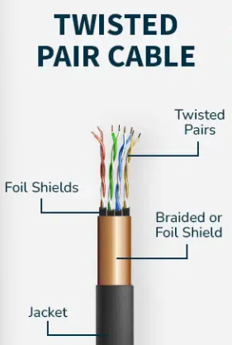
Examples
Office Local Area Networks (LANs): The standard yellow, blue, or grey Ethernet cables used to plug desktop computers into office wall outlets or switches.
Home Internet: Connecting your home computer directly to the back of your Wi-Fi router box for a faster, stable connection.
Landline Telephones: Older home telephone systems used basic twisted-pair copper lines to carry voice signals from the street into the house.
Why it is Good (Advantages) | Where it Fails (Disadvantages)
- It is highly flexible, lightweight, and very thin, making it incredibly easy to pull through office walls and under carpets. | - It has a short physical distance limit, as data packets begin to fade and degrade significantly after traveling just 100 meters.
- It is the cheapest wired media option available on the market for building local networks. | - It is vulnerable to electrical noise from nearby power lines, air conditioners, and fluorescent lights if not shielded properly.
- It is simple to install and crimp with basic, low-cost manual tools, requiring no specialized technical training. | - It offers lower maximum speeds and bandwidth caps compared to advanced fiber optic options.

Slide 50
COAXIAL CABLE
It is a heavy-duty copper cable designed with a round, layered structure to carry high-frequency electrical signals safely.
It features a solid, stiff copper wire right in the very center (the core) that carries the actual data packets.
The core is completely wrapped in a thick layer of plastic insulation, followed by a woven metal mesh shield, and a final tough plastic jacket.
The heavy metal mesh acts as a screen that blocks out almost all external background static and electronic noise.
How it works?
Data packets travel as high-frequency electrical signals along the central copper core.
The outer woven metal shield acts as an electrical ground, absorbing any incoming environmental interference before it can reach the core.
This layered shield allows the data packet to travel much further than it could in a standard twisted-pair cable without losing its shape.

Slide 51
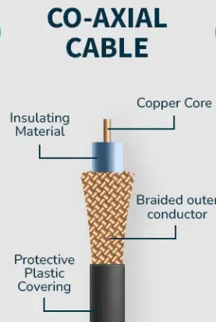
Examples
Cable Television (TV): The round, stiff black cable that screws into the back of your home TV set or cable box from the wall outlet.
Broadband Cable Internet: Used by television providers to deliver high-speed internet data packets into residential homes.
Why it is Good (Advantages) | Where it Fails (Disadvantages)
- It is highly resistant to external static and radio noise due to its thick, multi-layered metal shielding design. | - The cable is thick, heavy, and very stiff, making it difficult to bend around sharp corners or pull through narrow wall pipes.
- It can safely carry data packets across longer distances (up to 500 meters) before the signal needs a boost. | - If the central copper core gets bent or dented anywhere along the line, the entire cable's performance fails completely.
- It supports higher data capacities than basic unshielded twisted-pair lines. | - The specialized metal screw-on connectors (BNC connectors) are more expensive and take longer to install cleanly.

Slide 52
FIBER OPTIC CABLE
It is an ultra-high-speed network cable made out of incredibly thin strands of pure glass or plastic, each about the thickness of a human hair.
Instead of using electrical currents, fiber optic cables carry data packets using pulses of modulated Light.
It consists of a central glass core surrounded by a reflective glass layer called Cladding, which acts like a mirror to trap the light inside.
Because it uses light instead of electricity, it is completely immune to all forms of electrical noise, magnetic static, and lightning strikes.
How it works?
A laser or LED at the sending end converts digital 1s and 0s into super-fast flashes of light.
These light pulses bounce down the glass core line using a physics principle called Total Internal Reflection (the cladding mirror layer constantly bounces the light back into the core).
The light pulses travel at near the speed of light over immense distances without losing brightness, where a light-sensor on the receiving end decodes them back into digital data.

Slide 53
Examples
Undersea Global Links: Massive, heavily armored lines laid across ocean floors to connect continents and move global internet packet traffic between countries.
Internet Backbones: High-capacity data lines linking different cities, cellular towers, and massive data centers together.
Fiber-to-the-Home (FTTH): High-speed home internet connections provided by modern telecom companies for ultra-fast downloading and streaming.
Why it is Good (Advantages) | Where it Fails (Disadvantages)
- It offers almost infinite bandwidth capacity, supporting blistering data speeds up to several Terabits per second. | - It is highly expensive to manufacture, purchase, and deploy over large areas compared to copper.
- It can carry data packets across tens of kilometers without needing any signal boosters or amplifiers. | - The glass core is highly fragile; if you accidentally bend the cable too sharply, the glass inside will crack and shatter.
- It has zero vulnerability to electrical static, lightning, or magnetic interference, making it exceptionally reliable. | - It requires specialized, highly expensive laser alignment tools and trained engineers to cut, join, or splice two cables together.

Slide 54
UNGUIDED MEDIA (WIRELESS) – Radio Waves
What are Radio Waves?
Radio waves are low-frequency electromagnetic waves that can travel easily through the open air in all directions.
They operate in a frequency range from 3 Kilohertz (kHz) up to 1 Gigahertz (GHz).
They are Omnidirectional, meaning when an antenna sends out a radio wave, it spreads outward in all directions like a ripple in a pond.
They have a long wavelength property, which gives them the ability to pass straight through solid obstacles like walls, windows, and entire buildings.
How it works?
A wireless transmitter sends a data packet to an omnidirectional antenna, which converts the data into a radio frequency wave.
The wave propagates outward through space, passing through any nearby walls or obstacles.
Any receiving device within range with a matching antenna can intercept the wave and extract the data packets, regardless of its exact position or angle.

Slide 55
Examples
AM and FM Radio: Standard audio broadcasts sent out to car stereos and portable home radios.
Cellular Networks: Older 2G and 3G mobile systems used basic radio wave bands to transmit voice packets to cellular phones.
Cordless Home Phones: Handsets that talk wirelessly to their base station sitting across the living room.
Why it is Good (Advantages) | Where it Fails (Disadvantages)
- The waves can pass easily through solid walls and buildings, meaning you don't need a clear line-of-sight to communicate. | - Because they spread in all directions, they offer low security; anyone with an antenna nearby can capture and intercept your packets.
- It is excellent for mobile devices that move around constantly, as the transmitter does not need to be pointed at the receiver. | - They suffer from frequency crowding and interference if multiple transmitters in the same city try to use the same channel.
- It can cover massive geographical areas from a single high-power broadcast tower. | - They offer lower data rate capacity compared to higher frequency options like microwaves.

Slide 56
MICROWAVES
What are Microwaves?
Microwaves are high-frequency electromagnetic waves used for carrying large amounts of wireless data packets over long distances.
They operate at a higher frequency band than radio waves, ranging from 1 Gigahertz (GHz) up to 300 Gigahertz (GHz).
They are strictly Unidirectional, meaning the signal does not spread out; it shoots in a narrow, highly focused, straight beam.
Because they travel in straight lines, they require a perfect, clear Line-of-Sight path between the sending dish and the receiving dish.
How it works?
Data packets are converted into highly focused high-frequency microwave beams.
A parabolic dish antenna aims this tight beam directly at another dish antenna located miles away on top of a distant hill or tower.
Because the Earth curves, microwave towers must be built very tall and spaced roughly 30 to 40 miles apart so the straight beam doesn't shoot off into space.
They can also be shot straight up into space to communications satellites, which catch the packet and beam it back down to another continent.

Slide 57
Examples
Satellite Internet Links: Connecting remote scientific outposts or ships at sea to global networks via orbiting satellites.
Modern Wi-Fi and Bluetooth: Your home Wi-Fi router uses the 2.4 GHz and 5 GHz microwave bands to move packets to your laptop.
Inter-City Tower Links: Telecom companies use microwave dishes on towers to send phone and internet data between neighboring towns without digging up roads to lay cables.
Why it is Good (Advantages) | Where it Fails (Disadvantages)
- They carry massive amounts of data packets at high speeds due to their high frequency levels. | - They cannot pass through solid obstacles; a single tall building, hill, or tree block line-of-sight and kills the connection.
- It saves immense money in rugged terrains (like mountains) because you don't need to dig trenches or buy miles of physical cable. | - They are highly vulnerable to weather conditions; heavy rain, snow storms, or thick fog can absorb and weaken the microwave beam.
- They offer higher security than omnidirectional radio waves because the beam is focused straight at the intended target receiver. | - Constructing and maintaining tall microwave towers requires significant engineering precision and high initial costs.

Slide 58
INFRARED
What is Infrared?
Infrared waves are ultra-high-frequency, short-range wireless waves used for close-range data communication.
They operate at frequencies from 300 Gigahertz (GHz) up to 400 Terahertz (THz), which puts them just below visible red light.
They have very short wavelengths, which means they are completely unable to pass through solid walls or doors.
They are designed purely for private, secure, same-room communication over distances of just a few meters.
How it works?
The sending device uses a tiny LED light bulb to flash invisible infrared light patterns representing your data packets.
The wave travels across the room in a direct line-of-sight path.
The receiving device must have an infrared sensor aimed generally toward the transmitter to catch the light flashes and process the packet command.
If any solid object (like a cushion or a person walking by) steps into the path, the light beam is blocked instantly, and communication breaks.

Slide 59
Examples
Television Remote Controls: Changing channels or adjusting the volume on your home television set using a hand-held remote.
Wireless Mice and Keyboards: Connecting short-range desktop accessories to a nearby computer monitor base over a clean desk surface.
Data Transfer between Older Phones: In the early 2000s, users held two mobile phones completely still, side-by-side, to beam a contact card or photo packet via infrared ports.
Why it is Good (Advantages) | Where it Fails (Disadvantages)
- It offers incredible security because the signal cannot leave the room; a hacker sitting outside your house walls cannot spy on your data. | - It has an extremely short operational range, usually failing completely after traveling more than 5 to 10 meters.
- There are no licensing costs or frequency interference issues with nearby systems, as every room is its own isolated bubble. | - It cannot pass through any solid objects; a stray book or a hand blocking the sensor breaks the packet stream instantly.
- The electronics required to build infrared transmitters and receivers are dirt cheap and tiny. | - High amounts of direct outdoor sunlight can drown out the infrared light pulses, making it useless for outdoor communications.

Slide 60
Media Type | Category | Physical Medium / Frequency | Max Distance Limit (Before needing boost) | Line-of-Sight Required? | Vulnerability to Interference
Twisted Pair | Guided (Wired) | Copper Wire | ~100 Meters | Not Applicable | High (Electrical/Magnetic noise)
Coaxial | Guided (Wired) | Shielded Copper Core | ~500 Meters | Not Applicable | Low (Protected by metal mesh)
Fiber Optics | Guided (Wired) | Pure Glass Strands | Tens of Kilometers | Not Applicable | Zero (Uses light pulses)
Radio Waves | Unguided (Wireless) | 3 kHz - 1 GHz | Very Long (Global scale) | No (Passes through walls) | High (Frequency crowding)
Microwaves | Unguided (Wireless) | 1 GHz - 300 GHz | ~30-40 Miles (Terrestrial) | Yes (Strict straight line beam) | Medium (Impacted by rain/fog)
Infrared | Unguided (Wireless) | 300 GHz - 400 THz | ~5-10 Meters | Yes (Cannot cross solid walls) | Low (Confined to single room)

Slide 61
Physical Layer Core Responsibilities
When data travels down the OSI/TCP-IP stack, the Physical Layer receives a structured data frame from the Data Link Layer and executes the following programmatic and structural tasks:
A. Representation of Bits (Signal Encoding)
The Duty: The physical layer determines how to map the stream of logical 0s and 1s into physical signals.
The Logic: It defines the encoding type (e.g., Manchester encoding, Differential Manchester, or NRZ). For example, the software rules might dictate that a logical 1 is represented by a positive voltage change, while a logical 0 is represented by zero voltage change.

Slide 62
B. Data Rate (Transmission Speed)
The Duty: It establishes the transmission rate—the number of bits sent per second (bps).
The Logic: This is controlled by the physical layer architecture, which dictates the exact duration of a single bit slot (how long a transmitting device must hold a signal line high or low for the receiver to register it as a valid bit).
C. Bit Synchronization
The Duty: It ensures that the sender’s clock and the receiver’s clock are perfectly synchronized.
The Logic: Without synchronization, if the sender transmits at 1 Gbps but the receiver decodes at 990 Mbps, the receiver will miscount the incoming data pulses, leading to corrupt frames at the software layer. It fixes this using shared clock lines or self-clocking signal patterns.

Slide 63
D. Physical Topology Design
The Duty: It establishes how the individual network devices are physically arranged and cabled together.
The Logic: it dictates whether the facility will operate on a Star, Mesh, Bus, or Ring cable layout.
E. Transmission Mode Directionality
The Duty: It configures the physical direction of data flow across the media interfaces.
The Logic: It hardwires the channel circuits to operate in either Simplex (one-way), Half-Duplex (two-way alternating), or Full-Duplex (simultaneous two-way) communication modes.

Slide 64
Multiplexing – Need?
When a telecommunications company lays an expensive high-capacity fiber-optic cable under a river or builds a wireless transmission tower, the physical installation cost can be massive. If that physical medium could only carry one single data packet from one single computer at a time, the entire network would freeze up while thousands of other users waited for their turn. Buying a separate physical cable line for every individual smartphone or internet user on Earth is financially and physically impossible.
We need a mathematical and logical way to slice up a single high-capacity physical connection so that thousands of independent data packets can travel down the same wire simultaneously without blending together into data noise.

Slide 65
Multiplexing
Multiplexing in data communications is a method that combines multiple signals or data streams into one signal over a shared medium. This process allows for efficient use of resources and can significantly increase the amount of data that can be sent over a network.
The Multiplexer (MUX): A hardware or logical component that acts as a many-to-one selector, taking N input streams and merging them onto 1 shared line.
The Demultiplexer (DEMUX): A component situated at the receiver's end that acts as a one-to-many distributor, separating the combined stream back into its N original, independent data channels.

Slide 66
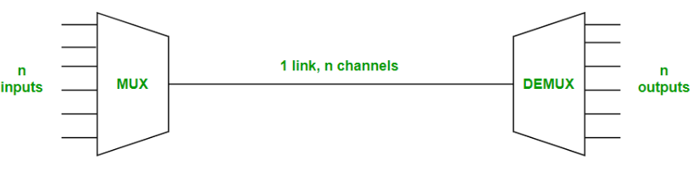
Multiplexing
Note: Multiplexing is the sharing of a medium or bandwidth. It is the process in which multiple signals coming from multiple sources are combined and transmitted over a single communication/physical line.

Slide 67
Multiplexing - Uses
Efficient Utilization of Resources: Multiplexing allows multiple signals to share the same communication channel, making the most of the available bandwidth. This is especially important in environments where bandwidth is limited.
Telecommunications: In telephone networks, multiplexing enables the simultaneous transmission of multiple telephone calls over a single line, enhancing the capacity of the network.
Internet and Data Networks: Multiplexing is used in internet communications to transmit data from multiple users over a single network line, improving the efficiency and speed of data transfer.
Satellite Communications: Multiplexing helps in efficiently utilizing the available bandwidth on satellite transponders, allowing multiple signals to be transmitted and received simultaneously.

Slide 68
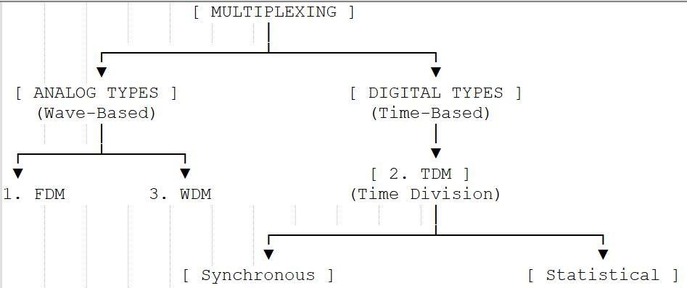
Multiplexing – Types / Strategies

Slide 69
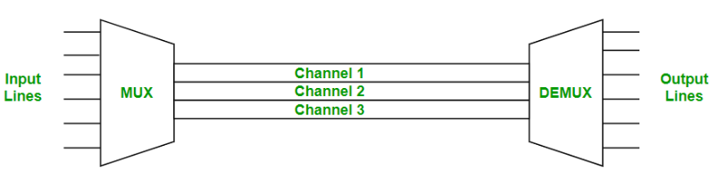
FDM (Frequency Division Multiplexing)
Frequency division multiplexing is defined as a type of multiplexing where the bandwidth of a single physical medium is divided into a number of smaller, independent frequency channels.
In FDM, we can observe a lot of inter-channel cross-talk because in this type of multiplexing the bandwidth is divided into frequency channels.
In order to prevent the inter-channel cross talk, unused strips of bandwidth must be placed between each channel. These unused strips between each channel are known as guard bands.

Slide 70
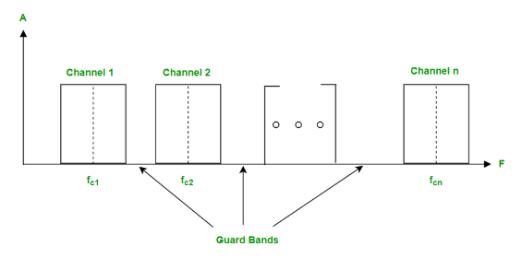
FDM (Frequency Division Multiplexing)
Note: Frequency Division Multiplexing is used in radio and television transmission

Slide 71
FDM (Frequency Division Multiplexing)
Example
Commercial Cable Television: A single coaxial cable wire enters your house. That wire carries data packets for Channel 10, Channel 20, and Channel 30 simultaneously.
Channel 10 is broadcasted strictly on the frequency band of 100 MHz to 106 MHz.
Channel 20 is broadcasted on 108 MHz to 114 MHz.
The space between them (106 MHz to 108 MHz) is an empty Guard Band to prevent video static. Your TV tuner simply shifts its internal focus to read one lane while ignoring the others.

Slide 72
FDM (Frequency Division Multiplexing)
Multiplexing Technique | Advantages | Disadvantages
Frequency Division Multiplexing (FDM) | * Does not require synchronization between transmitter and receiver clocks. * Supports simultaneous transmission from multiple sources without time delays. * Highly mature and robust for analog media frameworks. | * Prone to Crosstalk and intermodulation distortion. * Bandwidth is wasted due to the mandatory allocation of Guard Bands. * Hardware modifications are complex if changing the number of allocated channels.

Slide 73
TDM (Time Division Multiplexing)
Time-division multiplexing is multiplexing wherein FDM, instead of sharing a portion of the bandwidth in the form of channels, in TDM, time is shared. Each connection occupies a portion of time in the link. In Time Division Multiplexing, all signals operate with the same frequency (bandwidth) at different times.
Analogy: Imagine a narrow, 1-lane bridge. Cars cannot drive side-by-side. To let everyone cross fairly, a traffic guard sets a strict timer. For the first 10 seconds, only cars from Road A can cross. For the next 10 seconds, only cars from Road B can cross. Everyone gets to use the full width and maximum speed of the bridge, but they must take turns based on time.

Slide 74
WDM (Wavelength Division Multiplexing)
Wavelength Division Multiplexing (WDM) is a multiplexing technology used to increase the capacity of optical fiber by transmitting multiple optical signals simultaneously over a single optical fiber, each with a different wavelength.
Each signal is carried on a different wavelength of light, and the resulting signals are combined onto a single optical fiber for transmission.
At the receiving end, the signals are separated by their wavelengths, demultiplexed and routed to their respective destinations.
It is used in telecommunications, cable TV, ISPs, and data centers for high-speed, long-distance data transmission.

Slide 75
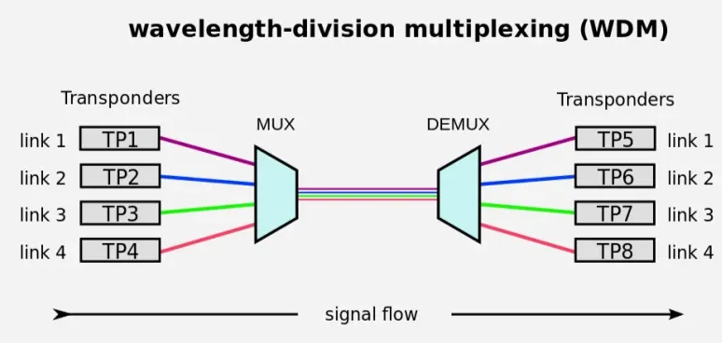
WDM (Wavelength Division Multiplexing)

Slide 76
WDM (Wavelength Division Multiplexing)
Wavelength Division Multiplexing (WDM) | * Yields massive transmission capacities over a single strand of fiber-optic glass. * Full duplex transmission can be achieved easily over a single link. * Highly secure and immune to electromagnetic interference (EMI). | * Extremely high initial cost for optical components, lasers, and prisms. * Complex optical amplification is required over very long geographical distances. * Tuning and alignment of precise laser wavelengths require specialized calibration.

Slide 77
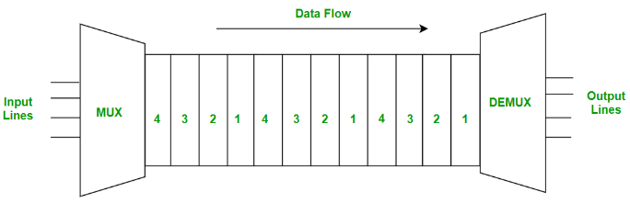
TDM (Time Division Multiplexing)
Time-division multiplexing is multiplexing wherein FDM, instead of sharing a portion of the bandwidth in the form of channels, in TDM, time is shared. Each connection occupies a portion of time in the link. In Time Division Multiplexing, all signals operate with the same frequency (bandwidth) at different times.
Note: There are two Types of Time Division Multiplexing - Synchronous Time Division Multiplexing & Statistical (or Asynchronous) Time Division Multiplexing.

Slide 78
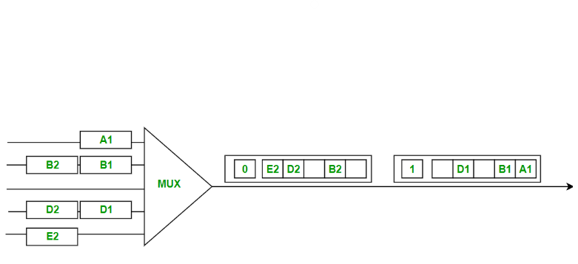
TDM : Synchronous TDM
A digital multiplexing technique where every input line owns a permanently reserved time slot in the output channel. The mapping is fixed and pre-allocated.
Frames: Time is divided into blocks called Frames. One frame represents one complete round-robin cycle of all input time slots.
Bandwidth Waste: It is inefficient for irregular traffic. If an input line has no data to send, its assigned slot travels down the wire completely empty and cannot be used by other devices.
Synchronization Bit: A single tracking bit is added to the beginning of each frame. This allows the receiver to align its clock and accurately split the incoming slots without needing complex address headers.

Slide 79
TDM : Statistical TDM
A dynamic digital multiplexing technique designed to maximize efficiency. Instead of reserving fixed slots for every line, the output frame collects data from active inputs until it is completely full, leaving zero empty slots.
Maximum Efficiency: Unlike Synchronous TDM, it does not waste bandwidth on idle devices. If an input line has no data to send, the system skips it entirely, ensuring the shared channel capacity is fully utilized.
Mandatory Addressing: Because slots do not follow a fixed, predictable order, the receiver cannot identify data by its time position. Therefore, the multiplexer must include the address (ID) of each particular data source inside its assigned output slot.
Bandwidth Optimization: By dynamically allocating slots only on-demand and skipping silent nodes, it improves overall bandwidth efficiency and allows more devices to share the line.

Slide 80
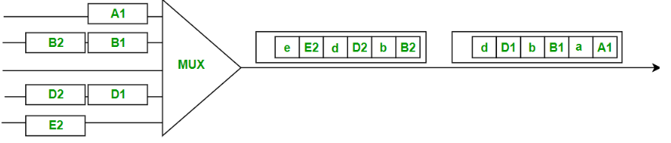
TDM : Statistical TDM
Instead of rigidly creating a 5-slot frame and leaving a blank space for the empty Line C (like Synchronous TDM would do), the Statistical MUX actively scans the queues and packs the output frames on-demand using only active data.
It processes the data in two sequential output bursts (Frames):
Frame 1 (The First Frame Sent on the Right)
The MUX looks at the first available packets in the queues: A1, B1, and D1.
It leaves zero empty slots for Line C.
It packs these three blocks tightly together into a single frame: [D1][B1][A1].

Slide 81
TDM : Statistical TDM
Frame 2 (The Second Frame Sent on the Left)
Once the first frame is sent, the MUX looks at the remaining packets left in the queues: B2, D2, and E2.
It packs them perfectly into the next frame: [E2][D2][B2].
The Need for Address Tags (The lowercase letters)
Look closely at the individual slots inside the output frames. You will see lowercase letters (a, b, d, e) attached right next to the data payloads:
a is the address header for Line A.
b is the address header for Line B.
d is the address header for Line D.
e is the address header for Line E.
Why are they there? Because the Demultiplexer (DEMUX) at the other end of the wire cannot predict when a line will be skipped. Without these lowercase tags, the receiver would get Frame 1 (D1, B1, A1) and assume that D1 belonged to Line A and B1 belonged to Line B. The address tags guarantee that the data is routed back to the correct software application.

Slide 82
Advantages of Multiplexing
Efficient Use of Bandwidth: You can send more than one signal over a single channel. This way, you can use the channel's capacity more efficiently.
Increased Data Transmission: Multiplexing can significantly boost the amount of data that can be sent over a network simultaneously, enhancing overall transmission capacity.
Scalability: Multiplexing allows networks to easily expand and accommodate more data streams without requiring significant changes to the existing infrastructure.
Flexibility: Different types of multiplexing (TDM, FDM, WDM, CDM) can be used based on the specific needs and characteristics of the communication system, providing flexibility in network design.

Slide 83
Disadvantages of Multiplexing
Synchronization Issues: Ensuring that multiple data streams remain properly synchronized can be challenging, leading to potential data loss or errors if not managed correctly.
Latency: Combining multiple signals into one can introduce delays, as each data stream needs to be processed, synchronized, and demultiplexed at the receiving end.
Signal Degradation: Over long distances, multiplexed signals can experience degradation and interference, requiring additional measures such as signal boosters or repeaters to maintain quality.
Resource Management: Allocating and managing resources for multiplexing can be complicated, requiring careful planning and real-time adjustments to avoid congestion and ensure efficient operation.

Slide 84
Modulation - Need?
Inside a computer's CPU or RAM, data exists as digital pulses (discrete square waves with sharp voltage jumps). However, physical transmission media like the open air, telephone lines, or satellite links are analog environments. They can only carry continuous, smooth electromagnetic sine waves.
If you try to blast a raw, jagged digital square wave directly through the air or across a long copper wire, the signal degrades almost instantly due to physical resistance (attenuation) and turns into unreadable garbage.
Modulation is the solution to this bottleneck. We take a perfectly smooth analog wave (called the Carrier Wave) that is naturally great at traveling long distances, and we intentionally alter its characteristics to "carry" our software bits hidden inside it. Without modulation, long-distance wireless networking, cellular data, and satellite communications would be physically impossible.

Slide 85
Modulation
A Modem (MOdulator-DEmodulator) is a translator device that sits between a computer and a network cable.
The Problem: A computer is a purely digital machine its operating system and software applications only understand discrete blocks of 0s and 1s. However, long-distance cables (like telephone lines, cable TV wires, or wireless space) are analog media—they can only carry continuous, flowing electromagnetic waves.
The Solution: * Modulation: Process by which data is converted into electrical/digital signals for transferring that signal over a medium is called modulation. It increases strength for maximum reach of the signals.
Demodulation: The process of extracting data from the transmitted signal is called demodulation.
Modem is a device that performs both modulation and demodulation processes.
The most commonly altered characteristics of modulation include amplitude, frequency, and phase.
Carrier signal: The signals that contain no information but have a certain phase, frequency, and amplitude are called carrier signals.
Modulated signals: The signals that are the combination of the carrier signals and modulation signals are modulated signals. The modulated signal is obtained after the modulation of the signals

Slide 86
Need?
To turn data into a wave, a modem modifies one of three basic properties of that continuous carrier signal.

